Slide 1
Delta Fountains
Dave Mariano and Jordan Humphries

Slide 2
Video Presentation

Slide 3
Dave

Slide 4
Dave

Slide 5
Dave

Slide 6
Planning and Schedule
App UI design
Joystick controller implemented
Socket server implemented
Signals sent to server
Subnet issue between Phone and Server

Slide 7
Reference Courses
CENG512 – Experience
CENG509 – Socket Server Programming
CENG300 – Android Development
CENG302 – System Analysis
CENG510 – Java Algorithms

Slide 8
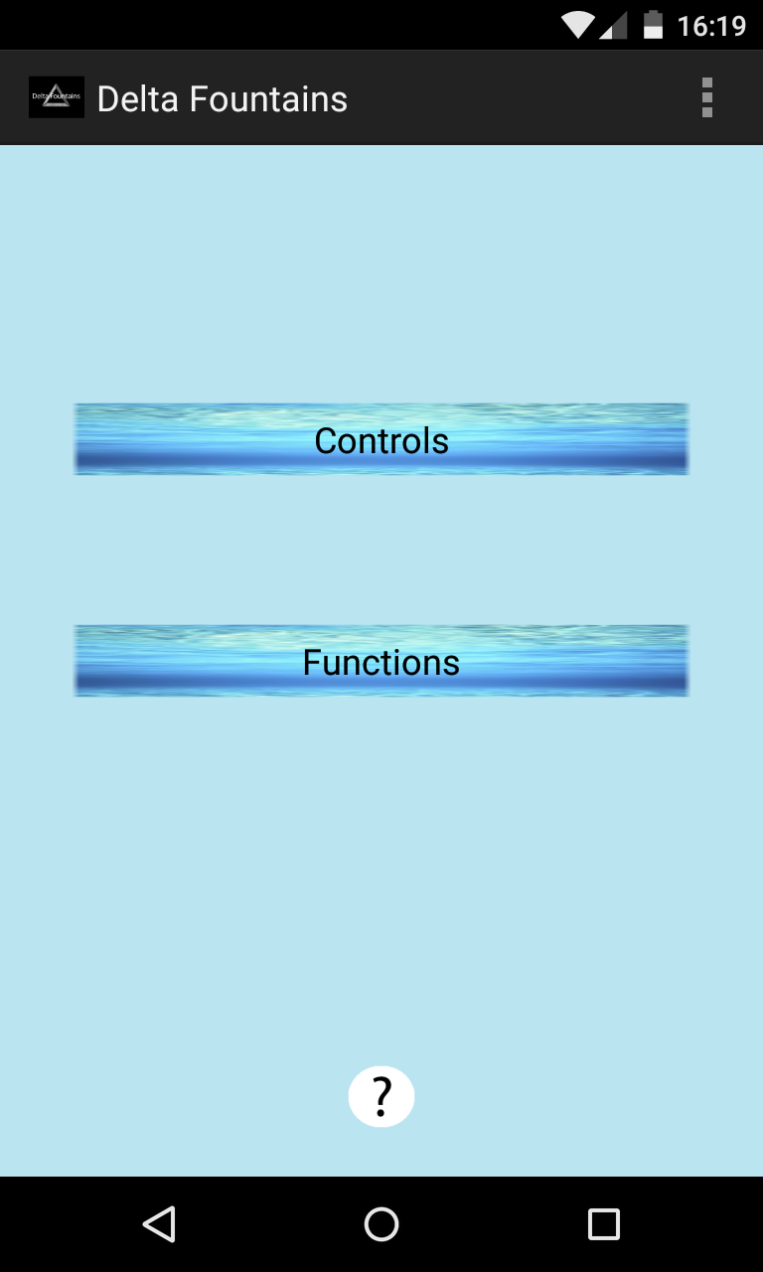
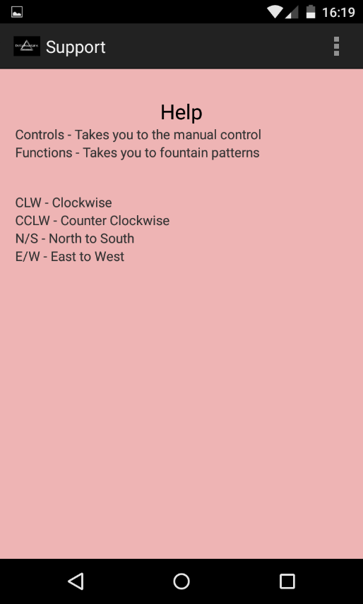
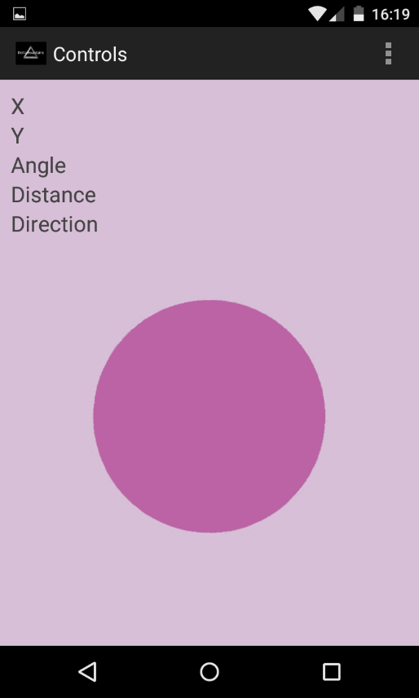
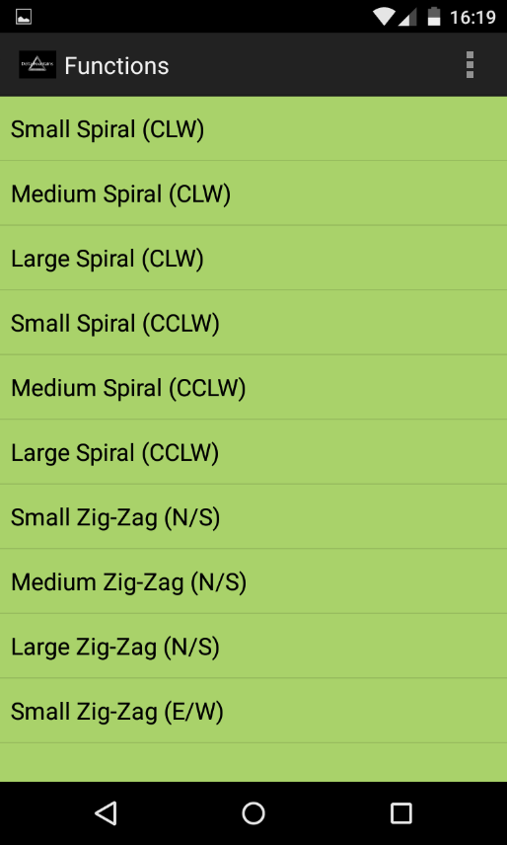
Main Screen
Help Screen
Keywords
Activities Description
Clicking on the Controls or Functions button will connect the app to the server
Controls is a joystick that sends a bearing to the server
Functions is a list of premade patterns for the fountain

Slide 9
Video Pitch

